Slide 1
TEACHER REFERENCE — not projected to students
Cycle 2 · Ecosystems & Feeding Relationships
Unit 1 · 3 blocks · Sep 07–18
ESSENTIAL CLAIM
Organisms in an ecosystem are connected by the transfer of matter and energy through feeding relationships.
NGSS PERFORMANCE EXPECTATIONS
HS-LS2-1 — factors that affect carrying capacity of ecosystems at different scales.
HS-LS2-2 — factors affecting biodiversity and populations in ecosystems of different scales.
OBJECTIVES
• Describe the levels of ecological organization.
• Build and interpret food chains and webs.
• Explain producer, consumer, and decomposer roles, and how energy is lost at each step.

Slide 2

1
Day 1 of 3 — the most teaching
Where your energy comes from
Bellringer + a short sim.
The big idea: living things are connected by how energy and matter move.
Critical Aspect 1: energy flow through the food chain.
Start your food web (Critical Aspect 1) — you'll finish it next class. Submit your notes.

Slide 3

2
Bellringer
Today
Think about the last meal you ate. Where did the energy in that food originally come from? Write your best guess.
TOPIC
Energy and feeding in ecosystems
SHORT SIM
BioMan Ecology Games — remove one species from a food web. What happens?
KEY TERMS
Autotroph — makes its own food
Heterotroph — must eat food
Producer / consumer / decomposer
Trophic level — a step in the chain
Energy pyramid

Slide 4

3
Big idea: living things are connected by how energy and matter move between them.
What we're figuring out today:
1. How do organisms get their energy — what separates the makers from the eaters?
2. Why does energy run out so fast as it moves up a food chain?

Slide 5

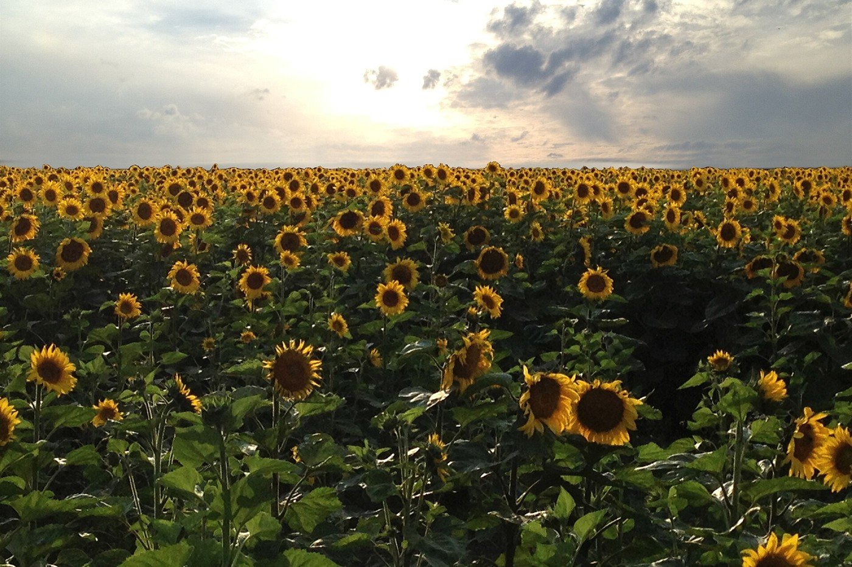
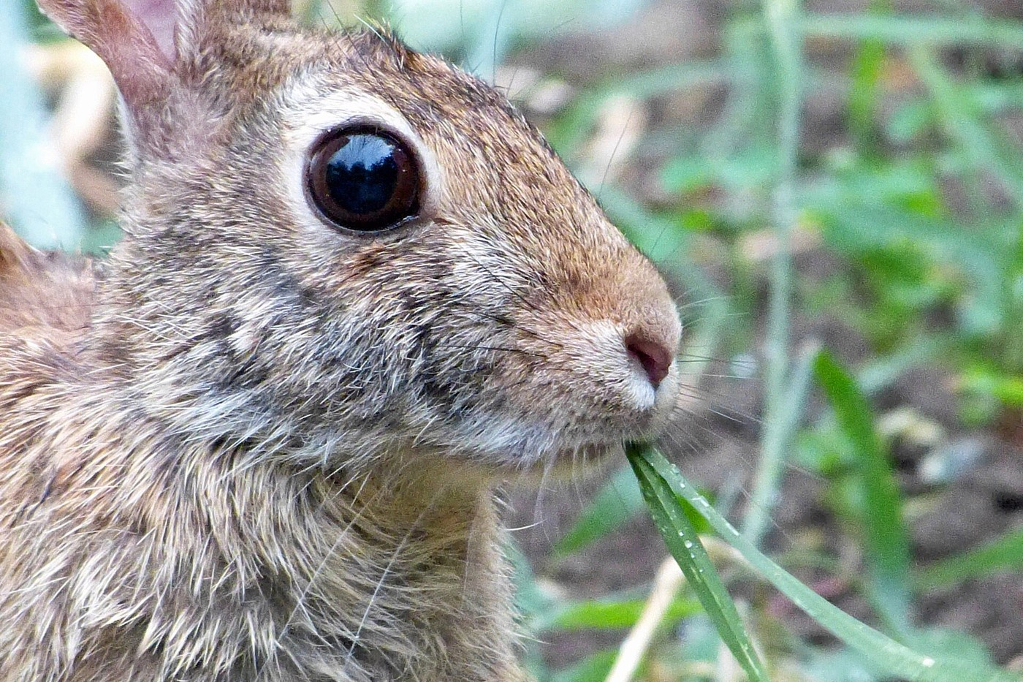
4
Makers and eaters
Autotrophs = makers
Heterotrophs = eaters
Make their own food. Also called producers. Most use sunlight (plants, algae, some bacteria). A few use chemicals.
Must eat other things. Also called consumers: herbivores eat plants, carnivores eat animals, omnivores eat both, decomposers eat dead things.
Every living thing needs energy. The difference is whether it makes its own or has to eat.

Slide 6

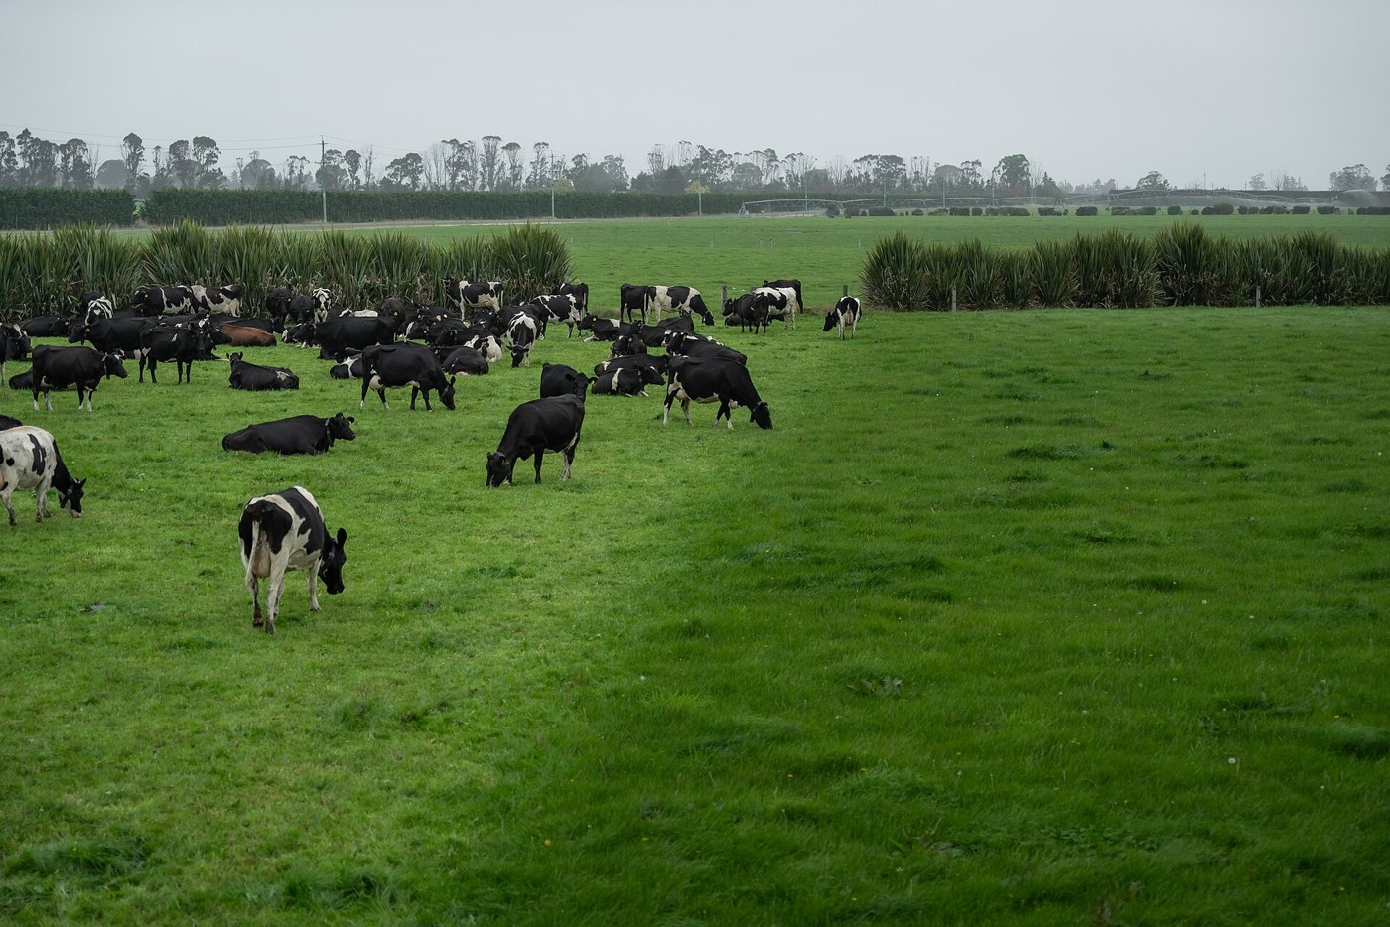
5
Zoom out from your plate
One cow — an organism.
All the cows that breed together — a population.
Every living thing they interact with — a community.
Add the soil, water, air, and sun — an ecosystem.
Every ecosystem with the same climate — a biome.
Everywhere life exists — the biosphere.
Each level adds something new: more individuals, then other species, then the non-living world.

Slide 7

6
Critical aspect: Energy flow through trophic levels
The energy in your dinner started as sunlight. Grass catches sunlight, a cow eats the grass, you eat the cow. At each step, do you get all of the grass's energy — or something else? Why?
Think first. Discuss with a partner. Then write.

Slide 8
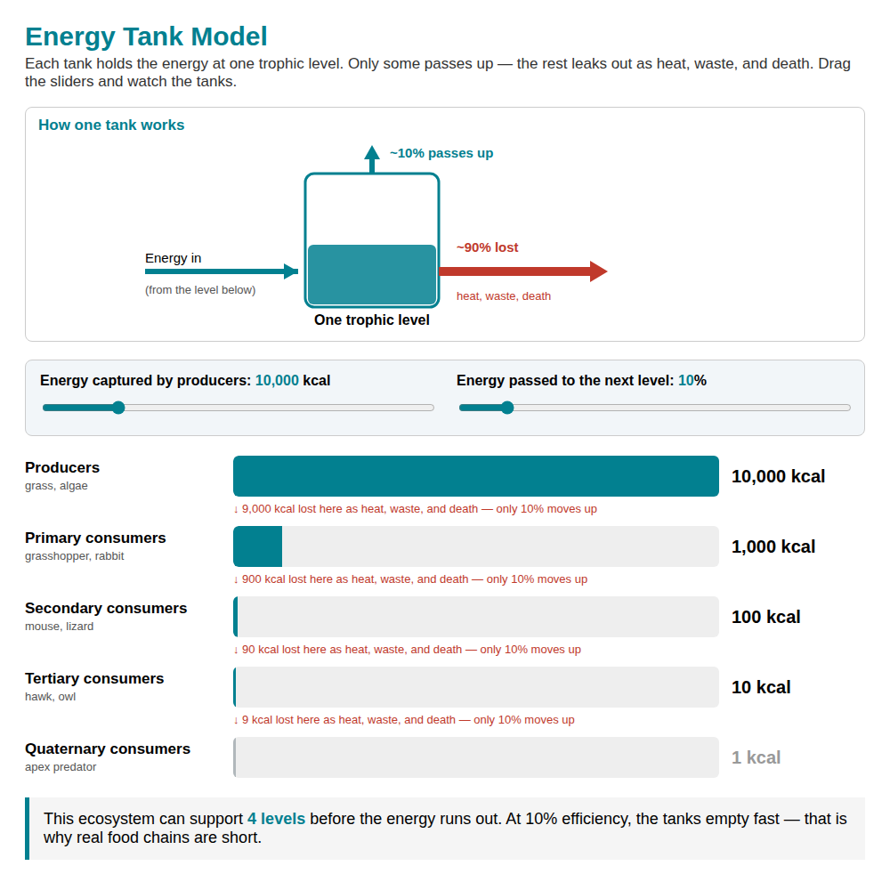
7
Explore — the Energy Tank Model
▶ Tap to open and drag the sliders — change the transfer efficiency and watch the tanks
https://answerable-biology-models.netlify.app/energy.html

Slide 9
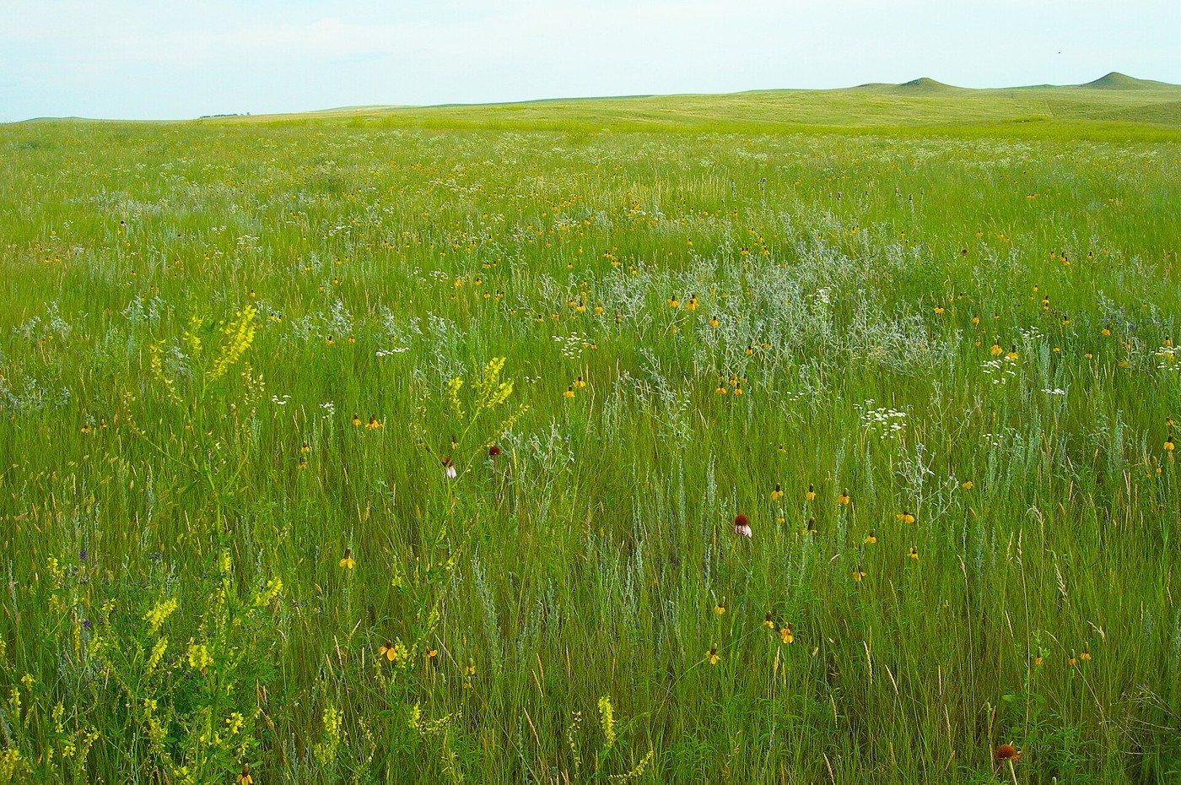
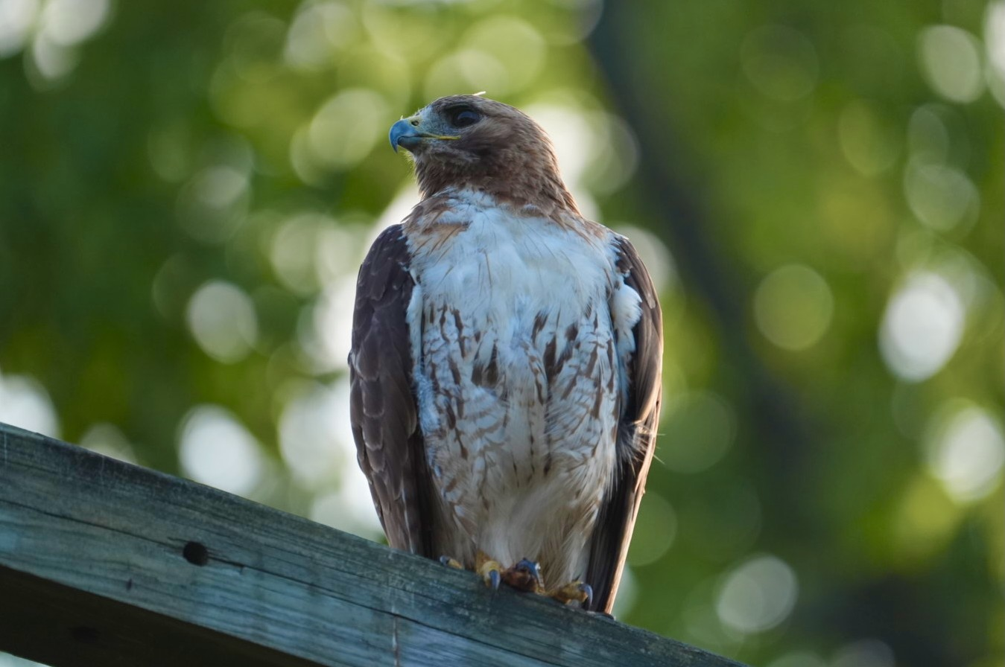
8
Critical aspect: Energy flow through trophic levels
Both live in the same meadow. So why thousands of grass plants but only a dozen hawks?
CASE A — Grass (producers)
CASE B — Red-tailed hawk
Thousands of plants. Catch sunlight directly. ~10,000 calories stored across the field. First trophic level.
10–15 hawks share the meadow. Can't make their own food. Eat rabbits, which eat grass. Third trophic level.
If the grass holds 10,000 calories, why can't the meadow feed 10,000 hawks?
Think first. Discuss with a partner. Then write.

Slide 10

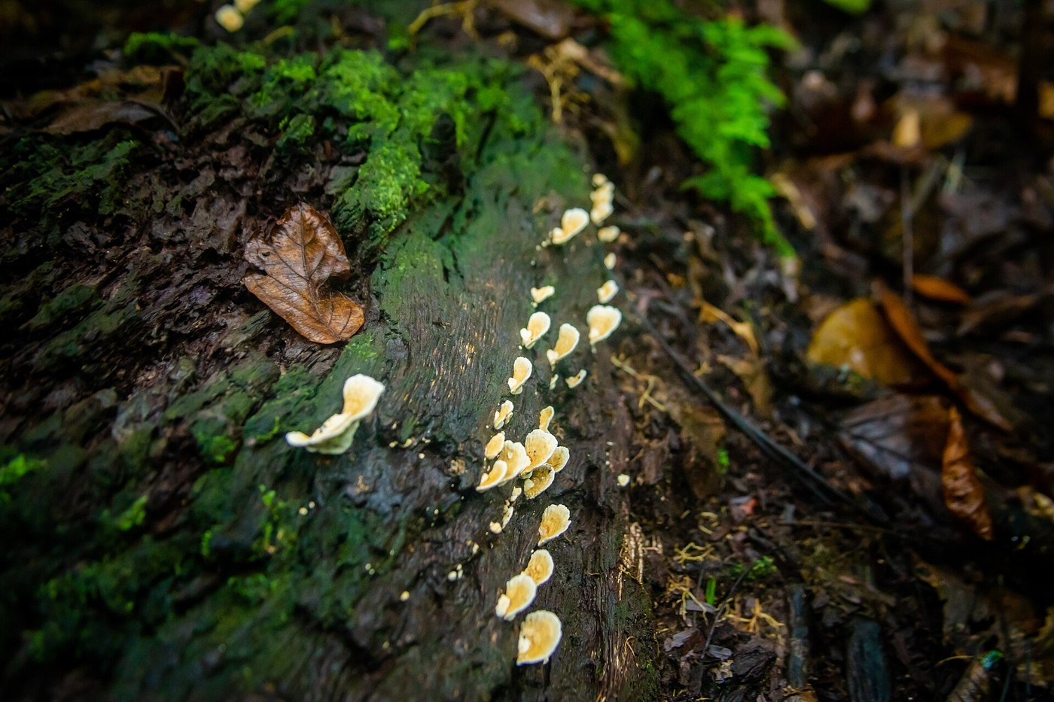
9
Critical aspect: Energy flow through trophic levels
Where does the other 90% go?
Only about 10% of the energy in one trophic level reaches the next. The rest doesn't vanish:
• Most is lost as heat when organisms use energy to live (respiration).
• Some leaves as waste that isn't eaten.
• Some organisms die without being eaten, so their energy isn't passed on.

Slide 11

10
Critical aspect: Energy flow through trophic levels
Build a rule from what you just saw
Finish this sentence as a rule:
“Each time energy moves from one trophic level to the next, ______________________.”
Think first. Discuss with a partner. Then write.

Slide 12

11
Pattern break / Critical aspect: Energy flow through trophic levels
Your rule said energy passes upward. But decomposers eat dead things at every level — dead grass, dead rabbits, dead hawks.
Where does a decomposer fit — 10% from one level, or energy from all levels at once? Does your rule still hold?
Think first. Discuss with a partner. Then write.

Slide 13

12
Keep going / Critical aspect: Energy flow through trophic levels
If energy is lost at every step and never comes back, why hasn't life run out of energy?
There's no answer to look up. Think it through and take your best guess.
Think first. Discuss with a partner. Then write.

Slide 14
13
Critical aspect: Energy flow through trophic levels
What has to be true about how organisms use energy for there to always be more producers than consumers?
Getting Started
A meadow stores 10,000 calories in its grass. How many reach the hawks (secondary consumers)? Show your math.
Working On It
Why can there never be more foxes than rabbits in a stable ecosystem — even if foxes are faster, better hunters?
Mastery
The 10% rule limits most ecosystems to 4–5 trophic levels. What would have to change for a 7-level ecosystem to be stable?
Word bank (use any, modify any, or use none):
[ trophic level ] [ biomass ] [ producer ] [ consumer ] [ energy pyramid ]
[ most energy is lost as heat during respiration ] [ only 10% passes to the next level ]
Think first. Discuss with a partner. Then write.

Slide 15
13b
Your answer — Critical Aspect 1 · Energy flow through trophic levels
Write your first answer now. On Day 3, open this slide’s Notes, run the prompt, and write your revised answer below — leave both showing. Seeing your thinking change is the point.
Your first answer
Your revised answer (after the AI prompt in the Notes)
Notes:
REVISION PROMPT — copy everything between the lines into your AI, and paste your first answer where it says [YOUR FIRST ANSWER]. The AI will NOT give you the answer — it helps you see your own thinking so you improve it yourself.
-----
I am a high school student. Below is a science question and my first answer. Do NOT rewrite my answer and do NOT give me the answer. Instead:
1. Tell me one thing I got right, and quote my own words back to me.
2. Ask me two questions that make me look again at one idea I might have wrong or left out.
3. Name one distinction or example worth thinking about.
Keep it short and in plain language, then stop so I can write my own revised answer.
QUESTION: The 10% rule limits most ecosystems to 4–5 trophic levels. What would have to change for a 7-level ecosystem to be stable?
[YOUR FIRST ANSWER]:
-----
Now write your revised answer in “Your revised answer” on the slide — in your own words.
TEACHER: the finished deck (first + revised answers) is the single artifact that runs through the AI pipeline → each student's printable Growth Report + class summary. Completion = both boxes filled.

Slide 16

14
Day 1 activity · Critical Aspect 1
Activity (Critical Aspect 1) — Start your food web
This activity belongs to today's critical aspect — energy flow. You start it now and finish it next class.
1. Take your set of species cards. Sort them into three piles: producers, consumers, decomposers.
2. Using each card's diet, draw arrows for who eats whom. Build a food web on your sheet.
3. Show your teacher your web before you leave.
Attempt the Mastery response, then SUBMIT YOUR NOTES. Present today = due today.
(We keep it simple this first cycle — the energy-pyramid math comes next class.)
Open: Feeding Relationships (Pacific NW) — PDF

Slide 17

15
Day 2 of 3 — finish, then the second idea
Who's connected to whom
First: finish your food web from last class (the energy-pyramid step).
Critical Aspect 2: how two species affect each other.
Guided notes, then attempt the Mastery response.
A short symbiosis activity, then submit your notes.

Slide 18
16
Day 2 · finish Critical Aspect 1 activity
Activity (Critical Aspect 1) — Finish your food web
Pick up your food web from last class. This is the energy-pyramid step.
1. Choose 4 organisms from your web and stack them into a pyramid — producers on the bottom.
2. Start with 10,000 units of energy in the producers. Using the 10% rule, how much reaches each level above? Fill it in.
3. In one sentence: why does the energy get smaller as you go up?
Open: Feeding Relationships (Pacific NW) — PDF

Slide 19

17
Critical aspect: Symbiosis and species relationships
A bee lands on a flower, drinks nectar, and carries pollen to the next flower. A mosquito lands on your arm, drinks your blood, and you itch for days. Both are two species interacting. So what is actually different?
Think first. Discuss with a partner. Then write.

Slide 20

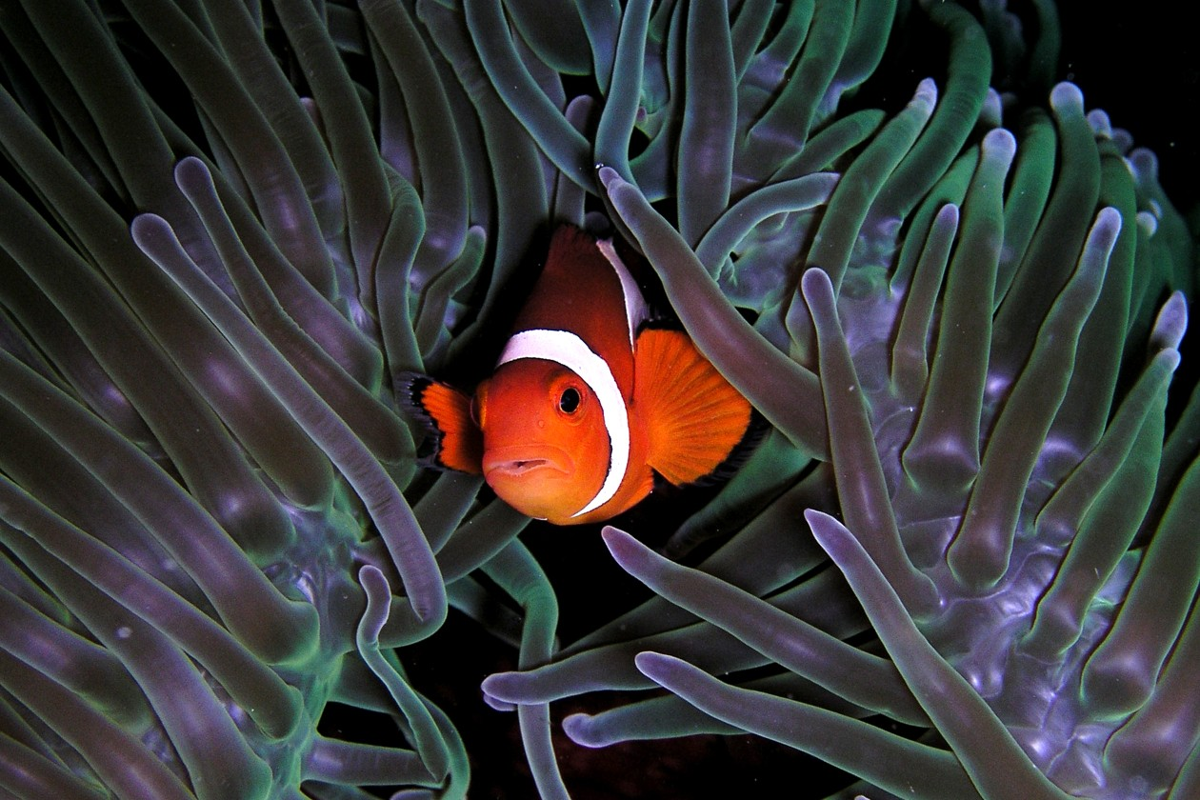
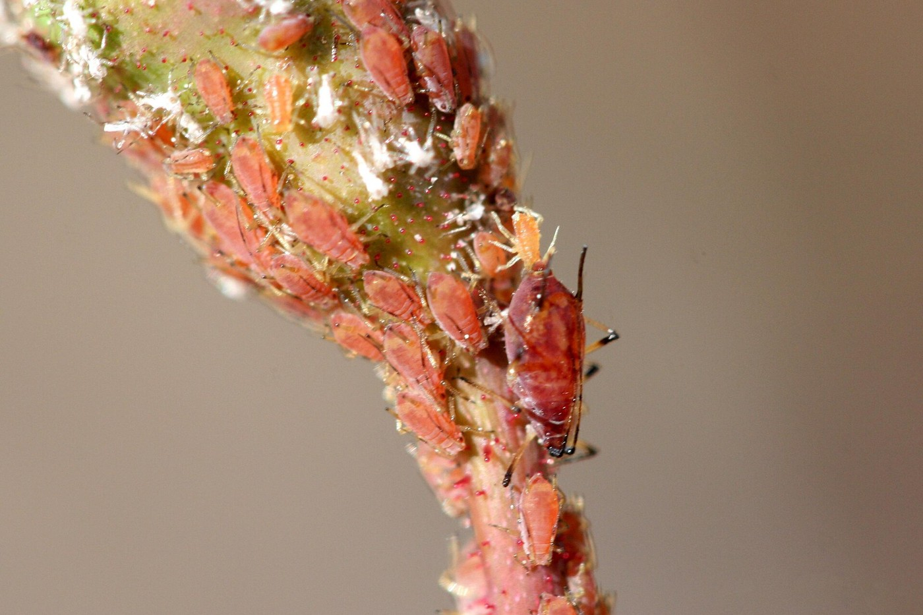
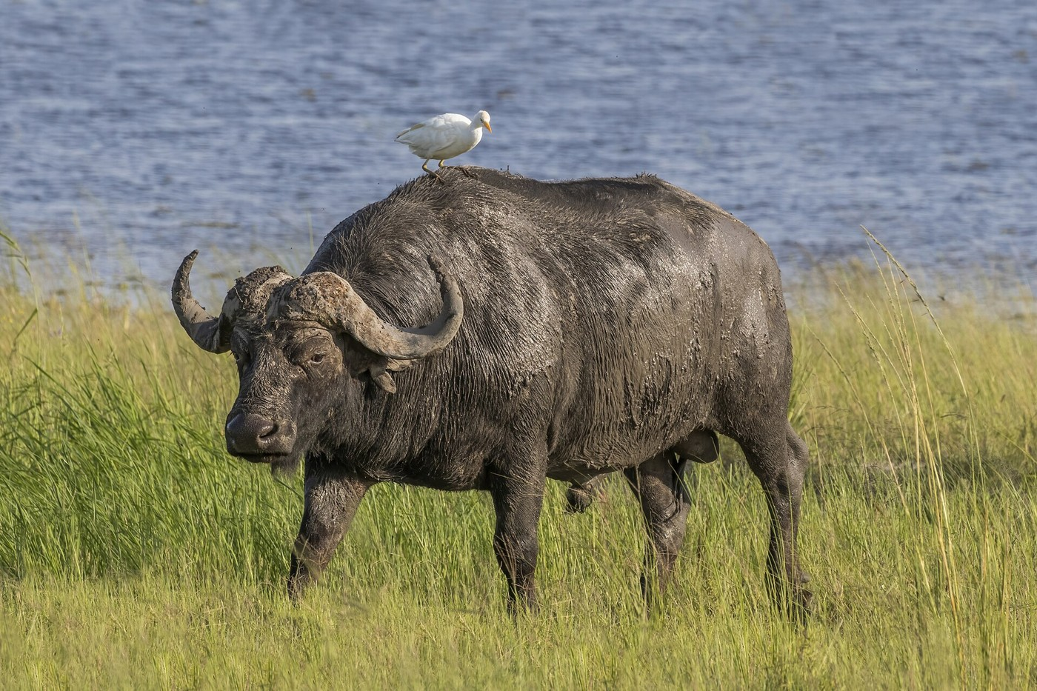
18
Three kinds of close relationship
Mutualism — both species benefit.
Parasitism — one is helped; the other is harmed.
Commensalism — one benefits; the other is neither helped nor harmed.
The name for these close relationships is symbiosis.

Slide 21
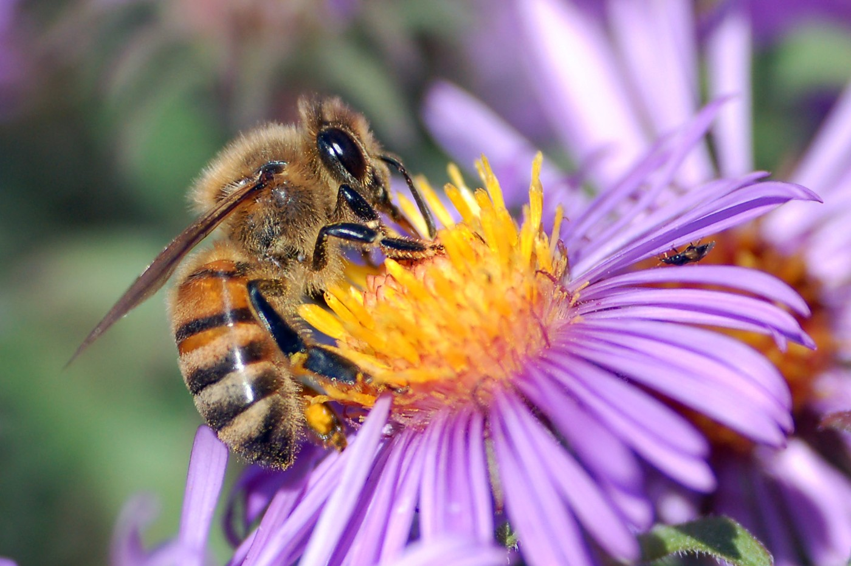
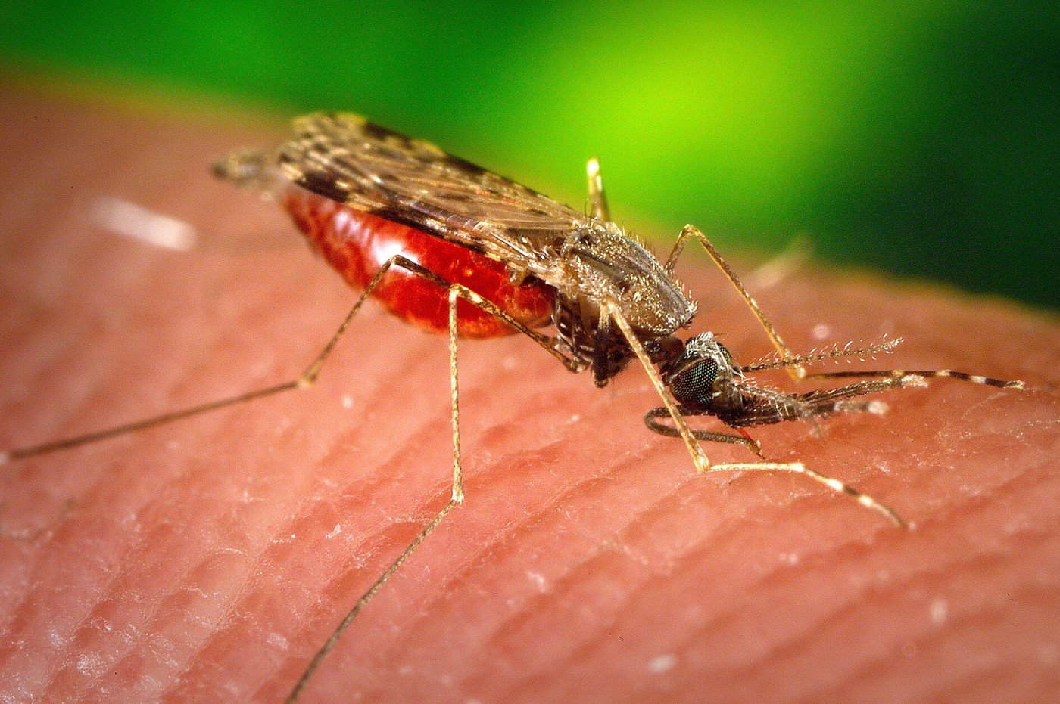
19
Critical aspect: Symbiosis and species relationships
Both get what they need. What makes them different — and why does it matter?
CASE A — Bee ↔ Flower
CASE B — Mosquito ↔ Human
Bee gets nectar. Flower gets its pollen carried to other flowers. Both walk away with something. Neither is harmed.
Mosquito gets blood. Human gets an itchy welt and maybe disease. One gains; the other loses. The cost is real.
Think first. Discuss with a partner. Then write.

Slide 22
20
Critical aspect: Symbiosis and species relationships
Build a rule from what you just saw
Finish this sentence as a rule:
“To identify what type of symbiosis two species have, you need to figure out ________________.”
Think first. Discuss with a partner. Then write.

Slide 23
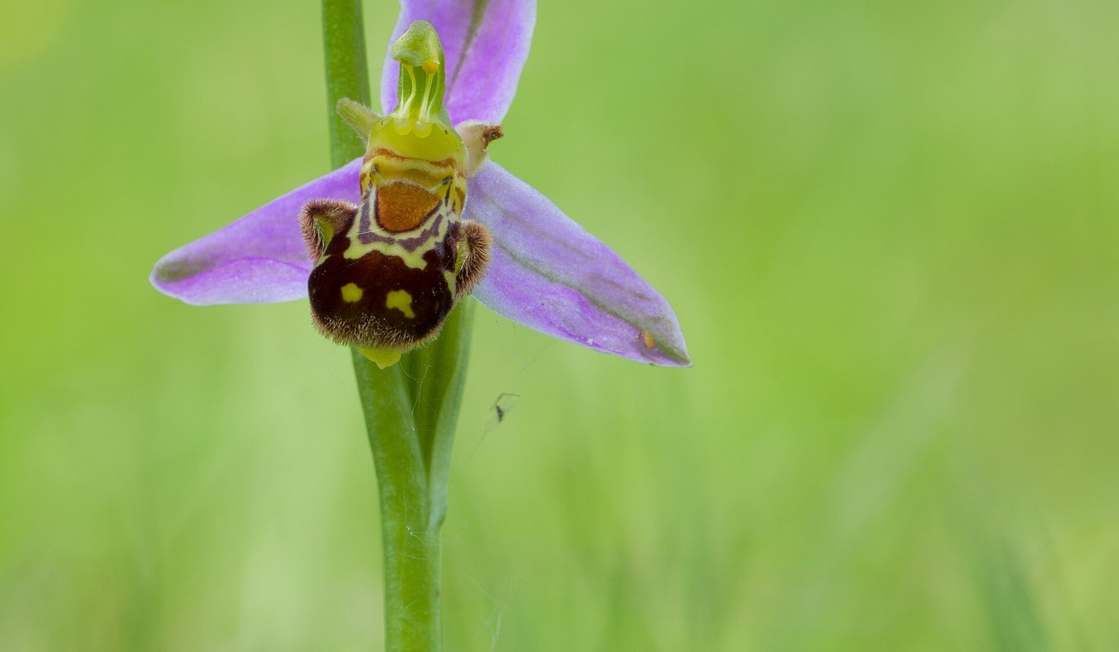
21
Pattern break / Critical aspect: Symbiosis and species relationships
Your rule said: figure out who benefits and who is harmed. But some orchids look and smell like female bees. A bee tries to mate with the flower, pollinates it — and gets no nectar at all.
Who benefits? Who, if anyone, is harmed? A new type — or does your rule still work if you apply it carefully?
Think first. Discuss with a partner. Then write.

Slide 24
22
Critical aspect: Symbiosis and species relationships
How does the outcome — who gains, who loses, or neither — decide the type of symbiosis?
Getting Started
A pilot fish eats scraps near a shark; the shark doesn't notice. Name the type and each organism's outcome.
Working On It
Two species evolve traits that only make sense if the other exists. What type are they in, and what's your evidence?
Mastery
A bee pollinates a flower (mutualism). If it evolved to steal nectar without touching pollen, what would the relationship become — and what happens to the flower over time?
Word bank (use any, modify any, or use none):
[ mutualism ] [ parasitism ] [ commensalism ] [ symbiosis ] [ niche ] [ coevolution ]
[ both gain ] [ one benefits, one is harmed ] [ one benefits, the other is unaffected ]
Think first. Discuss with a partner. Then write.

Slide 25
22b
Your answer — Critical Aspect 2 · Symbiosis and species relationships
Write your first answer now. On Day 3, open this slide’s Notes, run the prompt, and write your revised answer below — leave both showing. Seeing your thinking change is the point.
Your first answer
Your revised answer (after the AI prompt in the Notes)
Notes:
REVISION PROMPT — copy everything between the lines into your AI, and paste your first answer where it says [YOUR FIRST ANSWER]. The AI will NOT give you the answer — it helps you see your own thinking so you improve it yourself.
-----
I am a high school student. Below is a science question and my first answer. Do NOT rewrite my answer and do NOT give me the answer. Instead:
1. Tell me one thing I got right, and quote my own words back to me.
2. Ask me two questions that make me look again at one idea I might have wrong or left out.
3. Name one distinction or example worth thinking about.
Keep it short and in plain language, then stop so I can write my own revised answer.
QUESTION: A bee pollinates a flower (mutualism). If it evolved to steal nectar without touching pollen, what would the relationship become — and what happens to the flower over time?
[YOUR FIRST ANSWER]:
-----
Now write your revised answer in “Your revised answer” on the slide — in your own words.
TEACHER: the finished deck (first + revised answers) is the single artifact that runs through the AI pipeline → each student's printable Growth Report + class summary. Completion = both boxes filled.

Slide 26
23
Day 2 activity · Critical Aspect 2
Activity (Critical Aspect 2) — Living Together: the bobtail squid
This activity belongs to the second critical aspect — symbiosis. Observational, about 20 minutes.
1. Open the Living Together resource. Look at the Hawaiian bobtail squid. Write: what do you notice? what do you wonder?
2. The squid holds glowing bacteria in a light organ. What does the squid get? What do the bacteria get?
3. Name the type of symbiosis, and write one sentence of evidence for why.
Attempt the Mastery response, then submit your notes.
Open: Living Together — biointeractive.org

Slide 27

24
Day 3 of 3 — make it stronger
Rewrite, then push further
Reopen your Mastery answers and your feedback.
Revise them into a stronger DRAFT — this is the priority.
Work at your own pace; don't wait for the class.
Finished and strong? Take on the optional challenge.

Slide 28

25
What if? / Critical aspect: Energy flow through trophic levels
What if decomposers suddenly disappeared from every ecosystem on Earth — not just some, all of them? What would happen to energy flow within a year? Within a generation?
Watch first: decomposers video
Think first. Discuss with a partner. Then write.

Slide 29
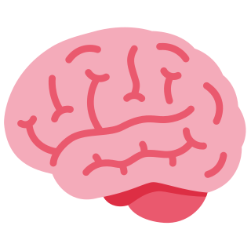
26
Optional challenge
Optional challenge (harder) — Break the web
For students who finished their draft and want to push further.
1. Go back to the food web you built. Choose one species and remove it completely.
2. Trace every arrow that touched it. Which populations grow? Which shrink? Which disappear?
3. Predict the web one year later, then one generation later. Defend each prediction with the 10% rule or a symbiosis type.
4. Hardest version: is there any single species whose removal would barely change the web? Explain what makes a species replaceable.
Open: Chains & Webs (Gorongosa) — biointeractive.org

Slide 30

27
Relates to me
This lesson had two critical aspects:
1. Energy flow through trophic levels
2. Symbiosis and species relationships
Pick ONE. In your own words, how does it connect to you — your body, your food, your home, someone you know, or something you have wondered about?
There is no right answer here. Write what is true for you.

Slide 31

28
Then and Now
Rate yourself: “I can trace how energy and matter move through an ecosystem, and why energy runs out.”
Before this lesson: Getting Started / Working On It / Mastery
Right now: Getting Started / Working On It / Mastery
Type your two ratings below, then one sentence on what changed.

Slide 32

29
Think → Write → Submit
☐ Finish your notes on all the slides.
☐ Write in your own words.
☐ Submit your notes to Schoology under [activity title] before class ends.
Present today = due today. Check your email for feedback.

Slide 33
30
Turn your answer into a draft
1. Open your Mastery answers from Day 1 and Day 2.
2. Read the feedback you were sent.
3. Rewrite each answer to make it clearer and give more evidence.
4. Save your draft and submit it.
This is today's priority. Work at your own pace — you don't wait for the class.

Slide 34
31
TEACHER NAVIGATION — do not project
Beat legend
What each slide is doing, in order.
1 Teacher reference — NGSS, claim, objectives
2 Day 1 divider
3 Bellringer — opening bid
4 Orientation — what we are figuring out
5 Contrast pair — makers and eaters
6 Scale — organism to biosphere
7 Critical Aspect 1 — phenomenon question
8 Interactive model — stock and flow
9 Contrast cases — grass and hawk
10 Explanation — where the energy goes
11 Build a rule — generalization
12 Pattern break — the case the rule misses
13 Continuation question — no answer key
14 Three-tier concept question
15 Activity — Critical Aspect 1
16 Day 2 divider
17 Activity — Critical Aspect 1, finish
18 Critical Aspect 2 — phenomenon question
19 Definitions — three kinds of relationship
20 Contrast cases — bee and mosquito
21 Build a rule — generalization
22 Pattern break — the case the rule misses
23 Three-tier concept question
24 Activity — Critical Aspect 2
25 Day 3 divider
26 What if — extension beyond the case
27 Optional challenge — harder, not required
28 Relates to me — student-generated relevance
29 Then and Now — retrospective self-rating
30 Closing checklist — submit
31 Rewrite into a draft — the Day 3 priority
32 This legend
33 Activity and resource links
34 Image credits

Slide 35
32
Activity and resource links
Bellringer sim — BioMan Ecology Games
https://biomanbio.com/HTML5GamesandLabs/EcoGames/ecology.html
Energy Tank Model (interactive)
https://answerable-biology-models.netlify.app/energy.html
Feeding Relationships (Pacific NW) — PDF
https://drive.google.com/file/d/1Jw2SU5hL2kzdLCNKFo0XxXE8sB6xcbSK/view
Living Together — HHMI BioInteractive
https://www.biointeractive.org/classroom-resources/living-together
Decomposers video
https://youtu.be/7cRgK0qG00E
Chains & Webs (Gorongosa) — HHMI BioInteractive
https://www.biointeractive.org/classroom-resources/creating-chains-and-webs-model-ecological-relationships

Slide 36
33
Image credits
All photographs from Wikimedia Commons. None generated by AI.
Slide 5 — Sunflower field in late afternoon sun with cloudy sky in M · Pittigrilli · CC0
Slide 5 — Rabbit Eating Grass by Monique Haen · M. L. Haen · CC BY-SA 3.0
Slide 6 — Dairy cows grazing with visible graze line · Halter · CC BY-SA 4.0
Slide 9 — Grasses and Forbs on the Cedar River National Grassland, D · Forest Service - Northern Region · Public domain
Slide 9 — Perched juvenile red-tailed hawk (Buteo jamaicensis) · Perryprog · CC BY 4.0
Slide 10 — DECAYING LOG · Suglo20 · CC BY-SA 4.0
Slide 19 — Amphiprion ocellaris (Clown anemonefish) in Heteractis mag · Nhobgood Nick Hobgood · CC BY-SA 3.0
Slide 19 — Macrosiphum rosae 5422189 · Whitney Cranshaw, Colorado State University · CC BY 3.0 us
Slide 19 — African buffalo (Syncerus caffer caffer) male with cattle · Charles J. Sharp · CC BY-SA 4.0
Slide 20 — European honey bee extracts nectar · John Severns (Severnjc) · Public domain
Slide 20 — Mosquito on human skin · James Gathany, USCDCP · CC0
Slide 22 — Ophrys apifera Bienen-Ragwurz 2014 · Tuxyso · CC BY-SA 3.0
Icons: Twemoji by X/Twitter, CC BY 4.0 — https://github.com/jdecked/twemoji

